Slide 1


Registering a WaterOneFlow Web Service With HIS Central
CUAHSI
HIS
Sharing hydrologic data
http://his.cuahsi.org/
Jeffery S. Horsburgh
David G. Tarboton, Kimberly A. T. Schreuders, David R. Maidment, Ilya Zaslavsky, and David Valentine
And the Rest of the CUAHSI HIS Team
Support
EAR 0622374

Slide 2
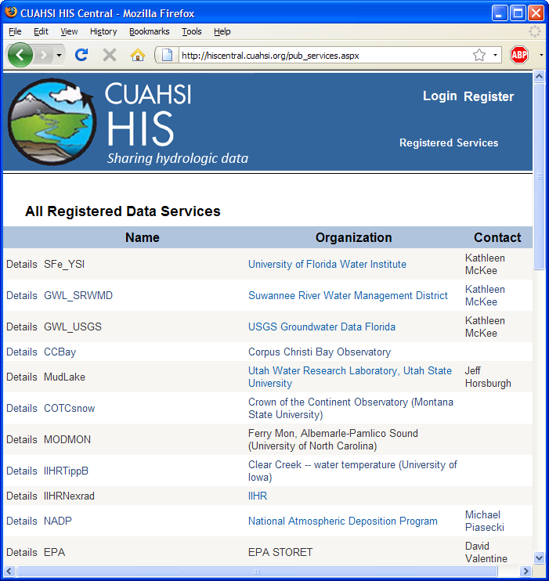
HIS Central
Publishers
Register a data service
Users
Find a data service
Components
Service registry
Metadata catalog
Ontology
Search services
http://hiscentral.cuahsi.org
Notes:
HIS Central keeps a listing of all registered web services, and also maintains a metadata catalog of site and variable information from those services to enable fast data searching.

Slide 3
Data Series – Metadata description
Time
There are C measurements of Variable V_{i} at Site S_{j} from time t₁ to time t₂
End Date Time, t₂
Count, C
Begin Date Time, t₁
Site, S_{j}
Space
Variable, V_{i}
Variables
Notes:
The metadata catalog stores the sites and a description of the data series available at those sites. A data series is all the measurements of a certain variable at a given site. HIS Central records the site and variable information as well as the begin date, end date, and number of measurements for each data series.

Slide 4
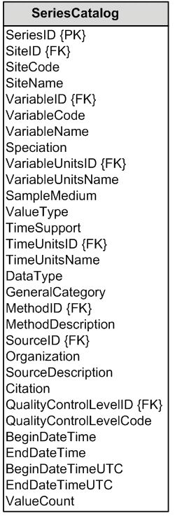
Series Catalog
S_{j}
Time
V_{i}
End Date Time, t₂
Count, C
Begin Date Time, t₁
Site, S_{j}
Space
Variable, V_{i}
t₁
Variables
t₂
C
Notes:
A collection of all data series across all registered web services is maintained in a single table called the SeriesCatalog.

Slide 5
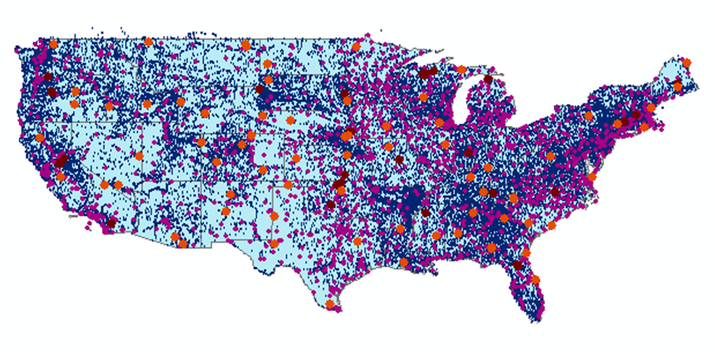
HIS Central Catalog
43 services
15,000 variables
1.8 million sites
9 million series
4.3 billion data

Slide 6
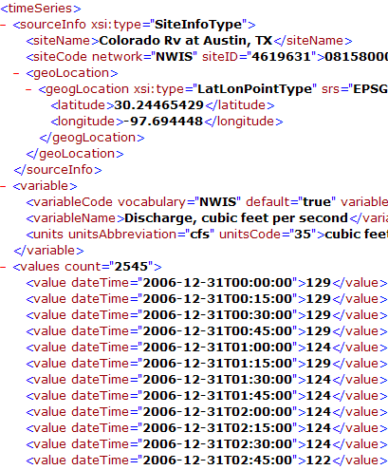
Data Heterogeneity
Syntactic mediation
Heterogeneity of format
Use WaterML to get data into the same format
Semantic mediation
Heterogeneity of meaning
Each water data source uses its own vocabulary
Match these up with a common controlled vocabulary
Make standard scientific data queries and have these automatically translated into specific queries on each data source
Notes:
HIS Central also helps tackle the problem of semantic heterogeneity. Recall that we use WaterML to standardize the format of data. This is called syntactic mediation. Yet even if everyone uses the same format for distributing data, they may still use different terms for describing data. For example, I might called my variable “discharge” while you call yours “streamflow”, although they’re really the same thing. We need another layer called semantic mediation to help sort out these differences.

Slide 7

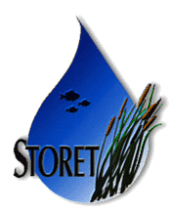








Data Searching
Search multiple heterogeneous data sources simultaneously regardless of semantic or structural differences between them
Searching each data source separately
NWIS
request
return
request
request
return
return
NAWQA
request
return
NAM-12
request
return
request
return
request
return
request
return
NARR
Michael Piasecki
Drexel University
Notes:
The old fashioned way to search multiple heterogeneous data sources is to construct a query that uses the right terminology for each source.

Slide 8

Semantic Mediation
Searching all data sources collectively
GetValues
GetValues
NWIS
GetValues
GetValues
generic
request
GetValues
GetValues
NAWQA
GetValues
NARR
GetValues
HODM
Slide From: Michael Piasecki
Notes:
With semantic mediation, we make a request for a generic hydrologic concept which automatically gets translated into the right terminology for each data source.

Slide 9
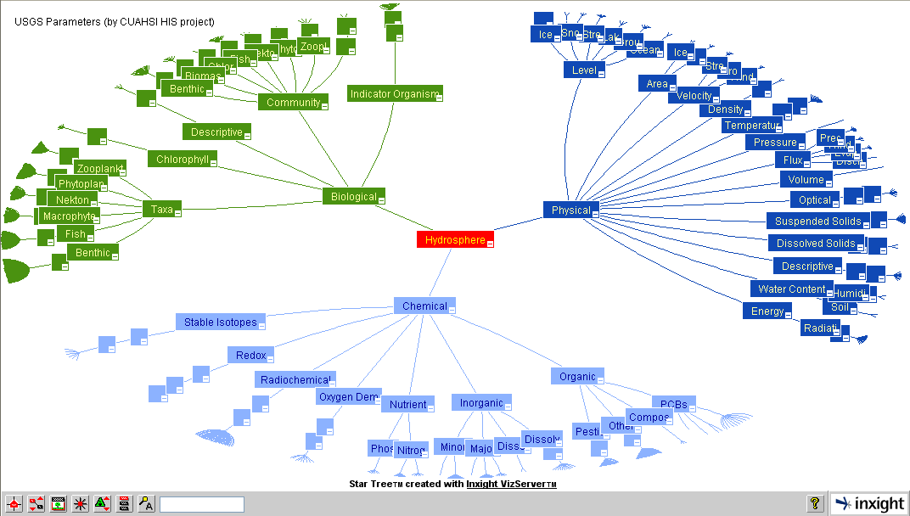
Hydrologic Domain Ontology to support concept based data discovery
Notes:
Generated by Dave V. It is the star tree for new ontology.

Slide 10
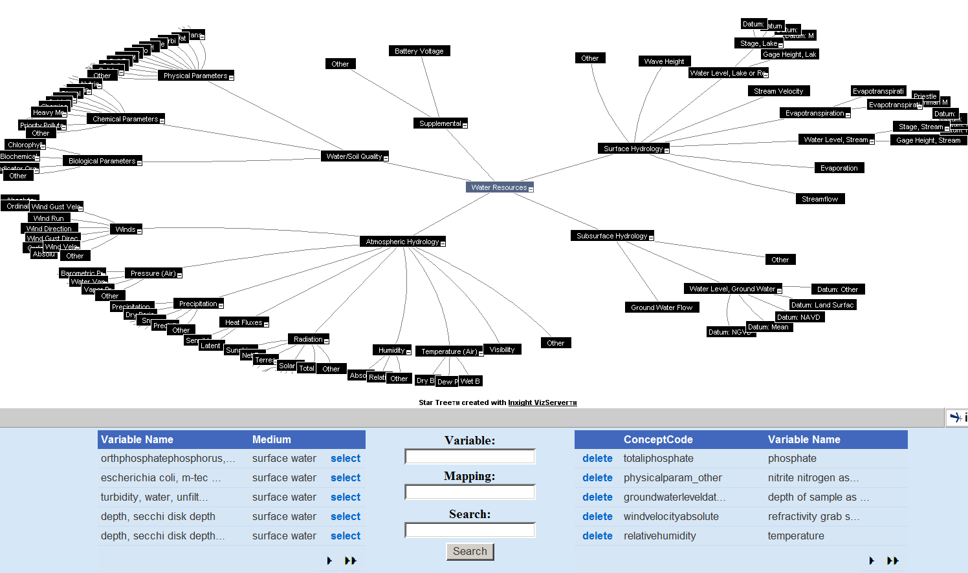
HydroTagger
Ontology: A hierarchy of concepts
Each Variable in your data is connected to a corresponding Concept
Notes:
These concepts are maintained in the HIS ontology. When people register their web service with HIS Central, they match the variables in their database to the concepts in the ontology. When users search for a keyword like “Nitrogen” in applications like HydroSeek, the software figures out what variables from the web service match that ontology concept and then constructs the appropriate queries for data.

Slide 11
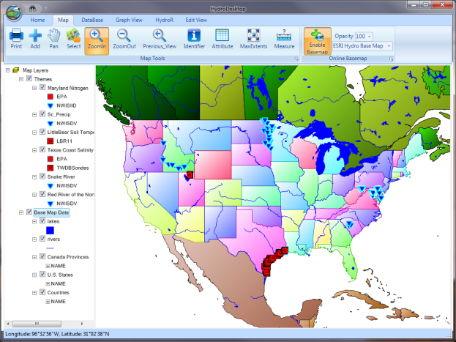
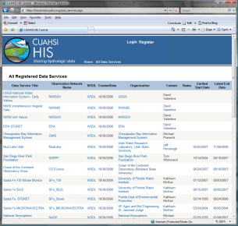
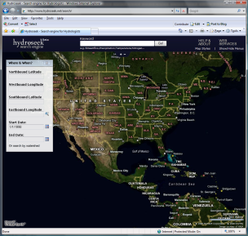
HydroServer Distributed Water Data Services
National Dataset Water Data Services
ODM
ODM
ODM
ODM
ODM
NWIS
STORET
DAYMET
SNOTEL
…
WOF
WOF
WOF
WOF
WOF
WOF
WOF
WOF
WOF
WOF
HydroDesktop
HIS Central
Metadata
Harvesting
Web Service Calls
WaterML
Desktop Analysis Software
Database API
Metadata
Catalog
R
Desktop Data
Repository
Search, Download, and Manage Data Subscriptions
Data Discovery
Calls
Metadata Services
MATLAB
Excel
Variable
Mapping
Visualize and Summarize (TSA)
Workflow
Convert Units
Ontology
Ontology
Services
Convert Formats and Export
Files
Import
HydroDesktop
Plug-ins
Files

Slide 12
Questions?
CUAHSI
HIS
Sharing hydrologic data
http://his.cuahsi.org/
Support
EAR 0622374

